Slide 1

IT AND SOCIETY
FATIMA EJAZ BARRI

Slide 2
CONTENTS
1.1
THE MOST SIGNIFICANT DEVELOPMENT IN IT OVER 50 YEARS
1.2
HOW IT HAS CHANGED SOCIETY IN THIS TIME PERIOD
1.3
HOW IT HAS CHANGED THE WAY PEOPLE WOK IN THIS TIME
2.2
THE IMPACT ON INDIVIDUALS OF LIVING THE INFORMATION AGE

Slide 3

1.1
THE MOST SIGNIFICANT DEVELOPMENT IN IT OVER 50 YEARS
The Internet
Digital Media
Personal Computers
Mobile Phones
Robots and Artificial Intelligence

Slide 4
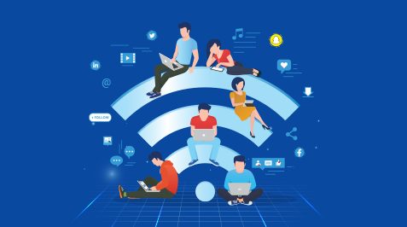
THE INTERNET
The world's largest and most unruly libaray, it is a gobal news channel social media, recsearch archive, shopping service and multimedia. the internet has transformed everything we once knew, it has updated our lifestyle in the major ways.
In this day and ages without internet it is nearly impossible to go about your daily life.

Slide 5
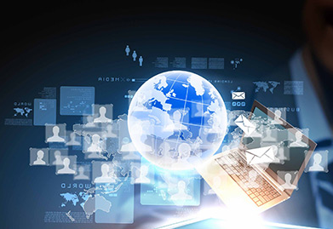
DITIGAL MEDIA
Ditigal media has updated our entertainment industry tremendously and help reshape it. nowadays, people can make music, animate, draw comics, make videos, edit pictures and videos all in a click or two.
There are so many apps that make it so much easier to erase or edit something apps that makes it so much easier to erase or edit something in a picture or video.
The differences are unnecognizable too.

Slide 6
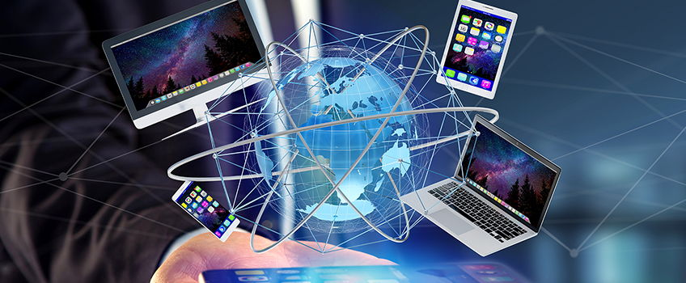
PERSONAL COMPUTERS
A personal computer is a general purpose, cost effective computer that is designed to be used by a single end-user. computer is dependent on information technology, which allows to set the entire CPU on a single chip.
In the mid 1960s and into the 1970s, computers occupied entire rooms and were only affordable by universites and enterprises. these were accessed by computer mltiple users via attached. Thats became popular in the early 1980s. 1980s technology had advanced far enough that small computer could be used and owned by a individual. they could use them to play games, and trade with friends across the country, while still looking busy, thanks to the computer.

Slide 7
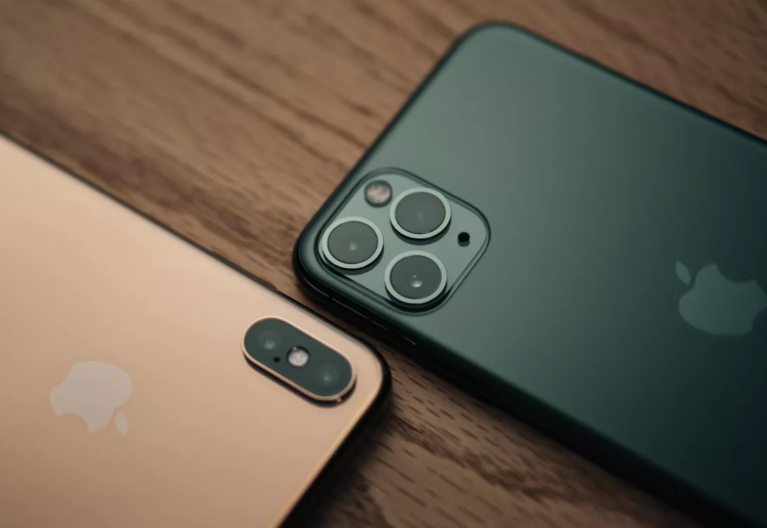
MOBILE PHONES
The mobile phones was first developed in the 1940s but it was not until the mids 1980s that they became widely available.
This is an old mobile phone which would have been used 50 years before technology had evolved. mobiles are the most evolutionary invention of the modern technology. before the phone there was other ways of communcication, you could send a letter or use a telegram.

Slide 8
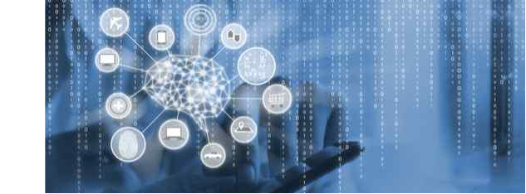
ROBOTS AND ARTIFICIAL INTEILIGENCE
Artificial intelligence uses machine learning to mimic human intelligence. the computer has to learn how to respond to certain actions.it uses algorithms and historical data to create something called a porpensity model.

Slide 9
1.2
HOW IT HAS CHANGED SOCIETY IN THIS TIME PERIOD
Education
Research
Communication
Travel
Entertainment
Financial Services
Healthcare
Marketing
Emloyment

Slide 10
SOCIAL LIFE BEFORE AND AFTER I.T
I.T is a source of information to world, a flexible medium commonly used by all age groups. two important components of the I.T. Mobile technology and social media is the main reason of its wide use.
Mobile technology has allowed people across the globe to communicate to each other. Social media has made communication easier through various apps designed to contact people throughout the world. There was life before the internet, though and that was a lot different. In some social fields, we can note numerous significant impacts of I.T. life:

Slide 11

EDUCATION
Human memory is declining over time and physical book, encyclopaedias are the case. The current generation does not use physical books as frequently as their ancestors did because there are convenient ways to access a book online. Once the physical books were the only information gathering source. Google is another good source for knowledge as it has a lot of results for one question while you had to search numerous books in libraries to get an elaborate answer.

Slide 12
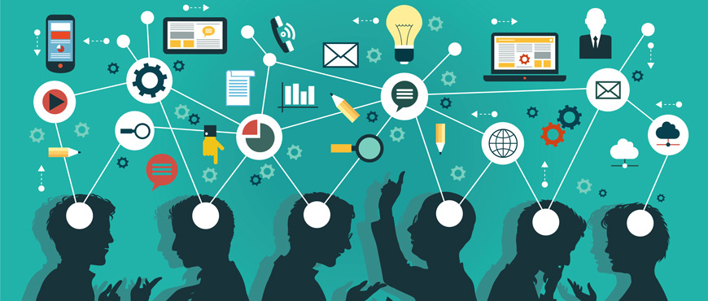
RESEARCH
Scientists use to spend a lot of time reading and referring books in library to better understand their case studies. Science requires a lot of notes which are hard to collect manually but with I.T. now you can save your notes in a lot of ways by highlighting it, bookmarking it, etc. The idea of libraries is somewhat lost since we're all using google to get details.

Slide 13
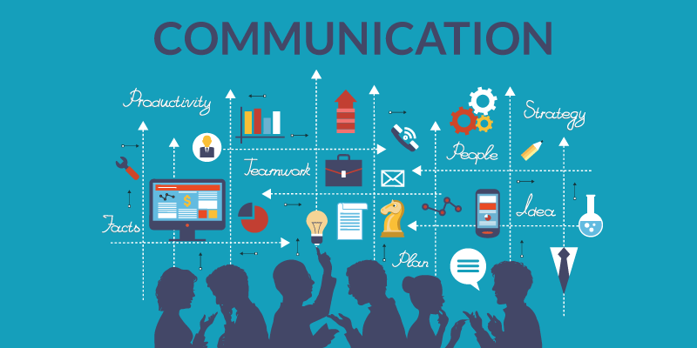
COMMUNICATION
Internet has made worldwide contact simple, you can contact someone with a few clicks in a state of emergency. It is also much easier to get details about one of your loved ones seated at another planet comer. You don’t have to write letters or pay extra for quick delivery of your messages through post.
Face-to-face communication has lessened due to the wide use of I.T. We started working differently and tend to find comfort communicating through a screen. You can easily get to know a person completely without talking to them by checking out their social profiles. We prefer video chat, teleconferencing and other online communication methods.

Slide 14
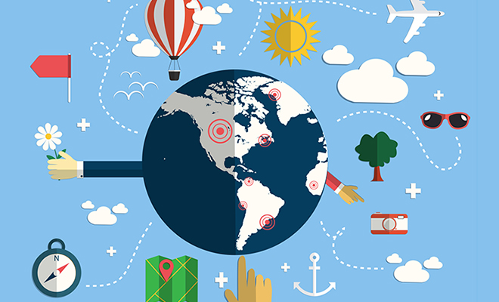
TRAVEL
Travel has been through a drastic difference too. You can plan a whole trip sitting at home and enjoy your vacation without any mismanagement. You can book flights, hotels, restaurants in another country through your phone or laptop. Tour guides have been replaced by GPS. I.T. has introduced a world of certainty and convenience.

Slide 15
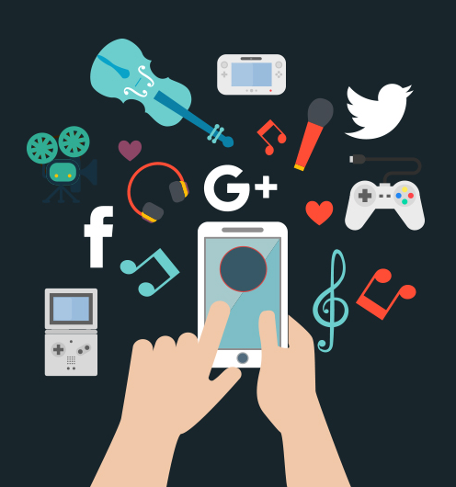
ENTERTAINMENT
Entertainment has been updated too, gone are the times when you had televisions, radios and consoles for entertainment. Now, you have all of it on your devices. Netflix has saved the day as you no longer have to pay for cable or wait in lines in a cinema. Mobile gaming has become a big industry due to its wide use among children. Internet has all kinds of entertainment for people to pick from.

Slide 16
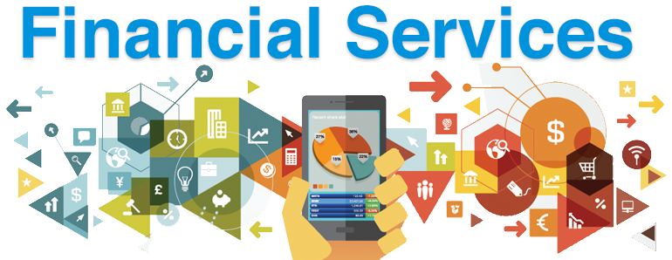
FINANCIAL SERVICES
The internet has made financial transactions easier too. People have reduced the amount of money they used to carry. Bills are being paid online instead of designated offices. Trade is also being done through mobiles and laptops. Everything is transitioning to being online.

Slide 17
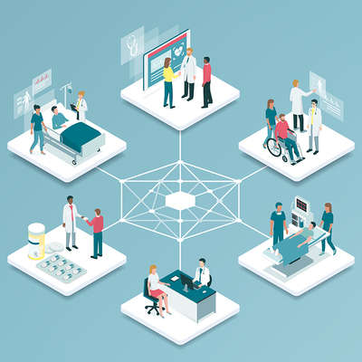
HEALTHCARE
I.T. has made each a doctor of his own. just enter the sign and learn the illness even more about administering your own medication. There is a sea of knowledge online but it can be misleading often so we should make sure we don’t believe everything we read.

Slide 18
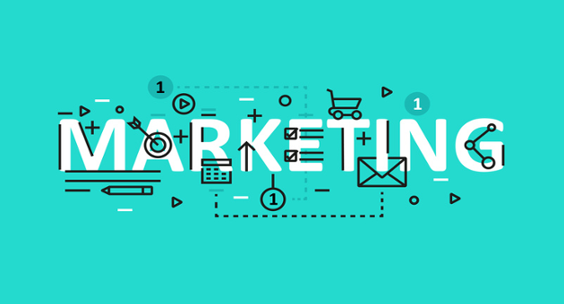
MARKETING
The way it is communication has a great market effect. web marketing strategies are evolving. Stores online are raking in customers and becoming successful as people prefer not going to the store, for example amazon, souq and dubizzle companies attract customers through content and give them a fun and personalized experience.

Slide 19
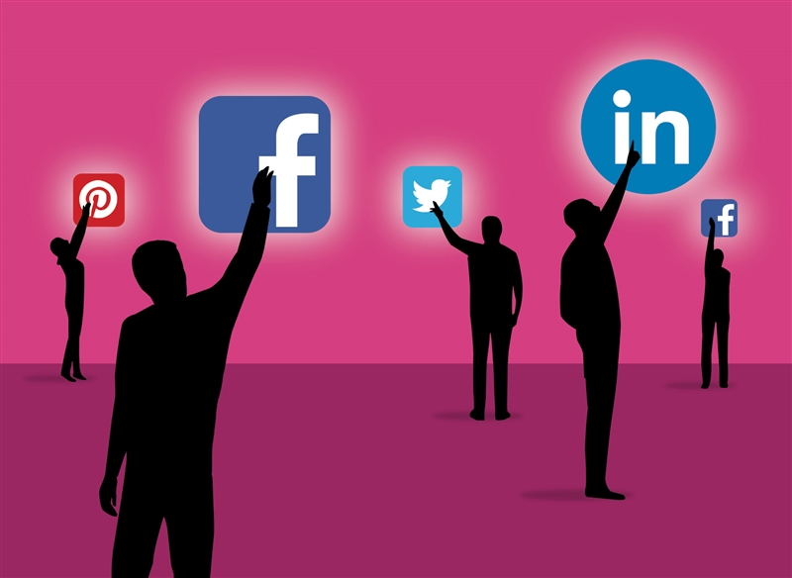
EMLOYMENT
Earlier employee productivity was evaluated by physical presence of eight hours in office. however, today things are different with help of I.T. Communication between staff has been made easy, offices develop a personalized software to make their staff’s work convenient. Employees can access their work from anywhere which has made it convenient for people to continue their work even when they have to take a break due to an emergency.

Slide 20
1.3
HOW IT HAS CHANGED THE WAY PEOPLE WORK IN THE LAST 50 YEARS.
Technology has changed healthcare
Technology have changed the automotive industry
How technology has changed banking industry

Slide 21
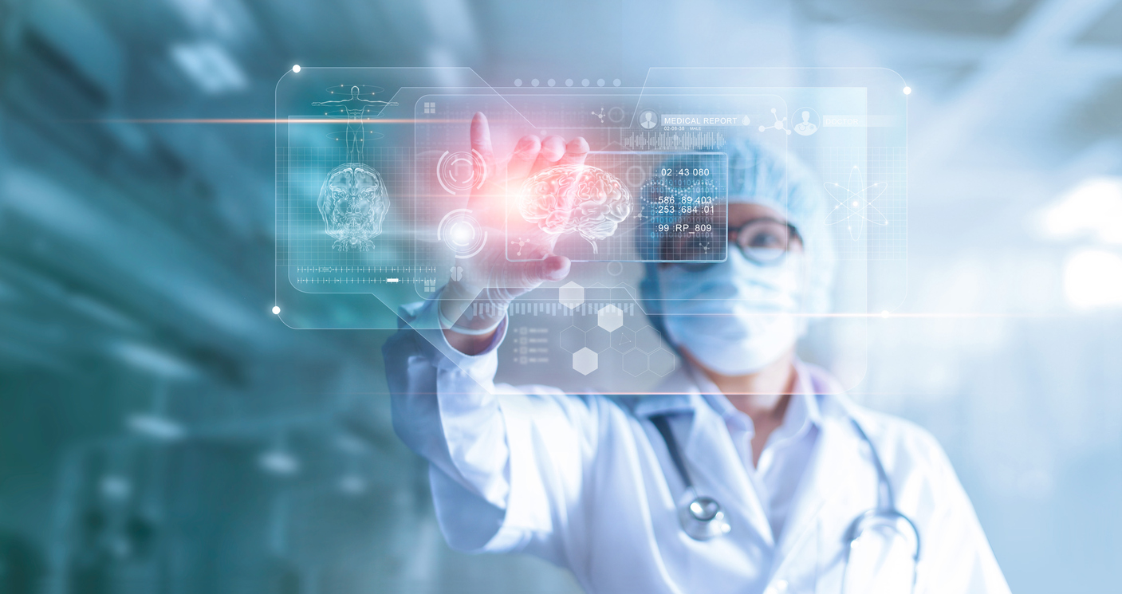
TECHNOLOGY HAS CHANGED HEALTHCARE
A number of industry analysts have observed that increased accessibility of treatment is one of the most tangible ways that technology has changed healthcare.
Health IT opens up many more avenues of exploration and research, which allows expert to make healthcare more driven and effectve than it has ever been.

Slide 22
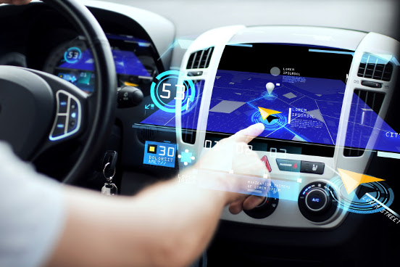
TECHNOLOGIES HAVE CHANGED THE AUTOMOTIVE INDUSTRY
Technology has already redefined how vehicles use fuel as the driving force of the future, with elector, electric and solar energy systems in automobiles starting to displace the internal combustion engine and gasoline-fed engines.
However, the growth of autonomous technologies and on going computers have simultaneously started to increase user interactivity whist decreasing the need for direst driving control.

Slide 23
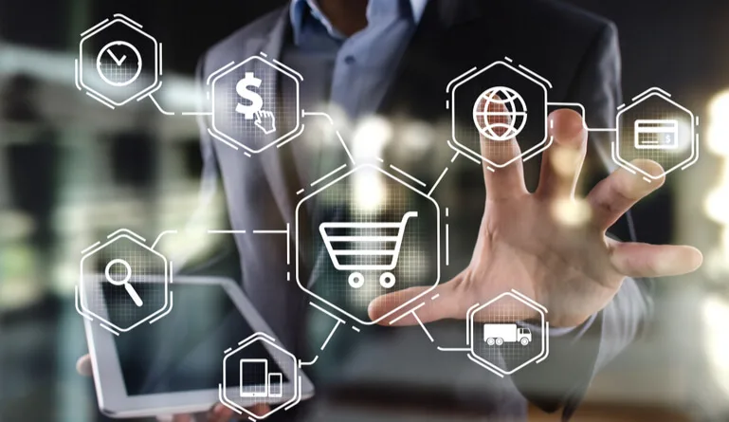
HOW TECHNOLOGY HAS CHANGED BANKING INDUSTRY
With the computer and electronics equipment facilities several banks have modernized their services. the revolution in technology has made it possible to provide the consumer with easiness and versatility in banking operations. the e-banks which can call as easy as the bank offers their following services:
Credit cards
ATM
E-Cheques
Electronic funds transfer
Mobile banking

Slide 24
Internet banking
Telephone banking
Electronic data interchange

Slide 25
2.2
THE IMPACT OF IT AN INDIVIDUALS OF LIVING IN THE INFORMATION AGE
The political impact of IT
The economicy impact of IT
The Social impact of IT

Slide 26
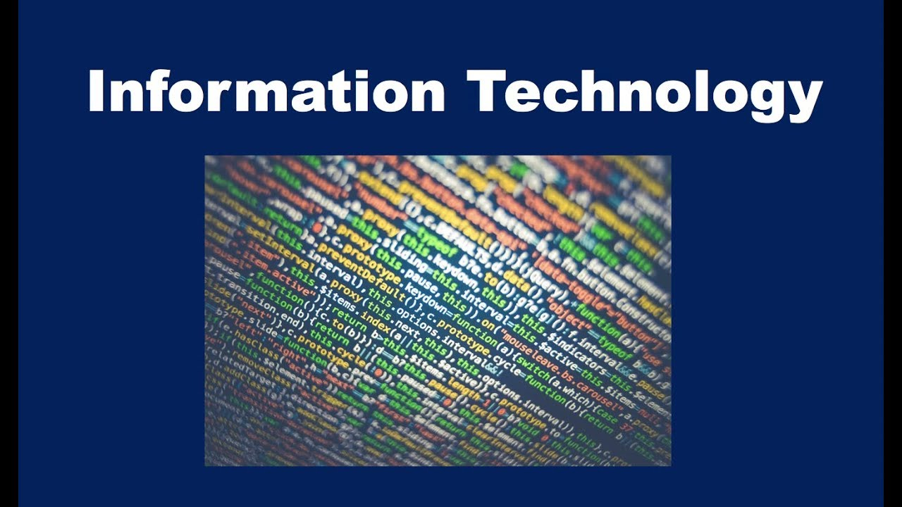
INFORMATION TECHNOLOGY:
Information technology, known by its abbreviation I.T. is the study of technology and computing and its use.
Almost all areas of life use I.T. in one or more aspects. It is hard for an individual to keep away from being online as life has become technological worldwide. It is expected for employees to have basic knowledge about computing and technology in every field. It has made life easier and convenient, no doubt but a lot of people believe it has more downsides to it.

Slide 27
1. EFFECTS ON EDUCATION
Information technology has improved the efficiency and productivity of the education process. it has improved student well being. developed instructions have encouraged this change, for example replacing books with tablets and laptops. ever step, e-learning platforms have made it easier for students to keep up with classes even when they are away. Such forums provide students with the opportunity to review the classes at all times with clearer and more concise descriptions, strengthening the educational process and leading to better outcomes for the students at school.

Slide 28
2. EFFECTS ON THE HEALTH SYSTEM
Medical devices have seen a fascinating advancement in the field of medicine. they grew more powerful. such devices have been entered by IT an made into digital devices which facilitate their progamming and handling. due to IT industries such as artificial inteligence, the world has seen distance surgeries due to robots, artificial members being artificial legs, hands and even artifical cardio-aortic valves.

Slide 29
IMPACTS OF INFORMATION TECHNOLOGIES
1. THE POLITICAL IMPACT OF I.T
Technology is the mainstay. information technologies plays a crucial role in the countries political landscape. in electoral campaigns, they have become commonly used to influence public opinion and particularly to include young people in the political life.
Politicians use technology in many ways to influence the development of different individuals in their respective worlds where the likes of twitter, Facebook and YouTube are effective means of communication media playforms that can easily raise politicians ratings. in most electoral campaigns technology is a defining factor. politicians are able to acess funds through technology, gain poitical support and spend less on campinging and pushing their candidacy.

Slide 30
2. THE ECONOMIC IMPACT OF I.T
Information technology is an all encompassing transition that affects the nature of many current produts and services, as almost all of them are the mode of production and marketing.
The global economy is going through a transition. web, mobile technology, social media and big data patterns, and nowadays, we are experiencing tremendous developments in teleology that are changing both industry and economy.

Slide 31
3. THE SOCIAL IMPACT OF I.T
Information technology has changed the way people perceive reality and in some dfintions and measures, it has created quite a disorder.
Modern technology has changed our perspective on many concept. it also changed our dealings with many traditions and customs that were once considered sacred and the pillars of society.

Slide 32
THANKS!

